Slide 1
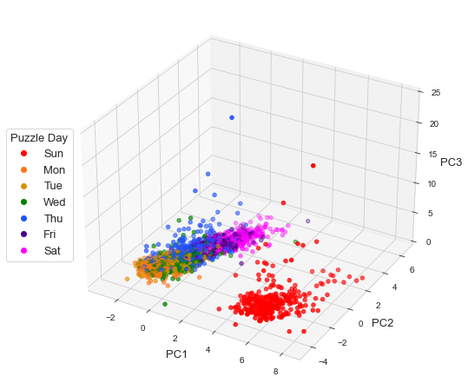
Notes:
Fig. 1

Slide 2
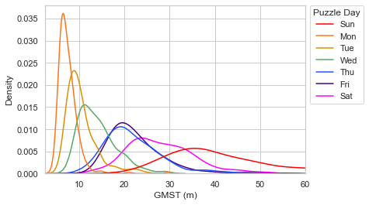
Notes:
Fig. 2

Slide 3
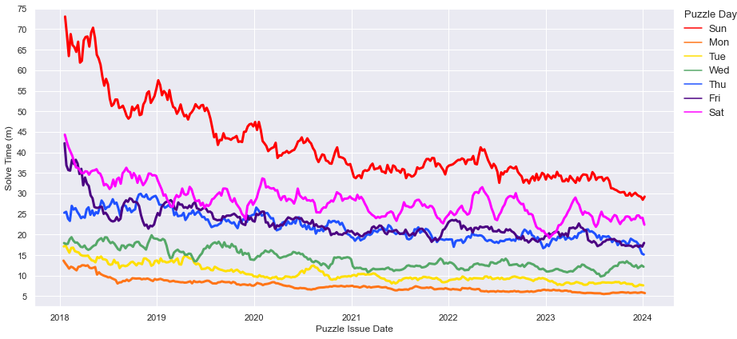
Notes:
Fig. 3

Slide 4
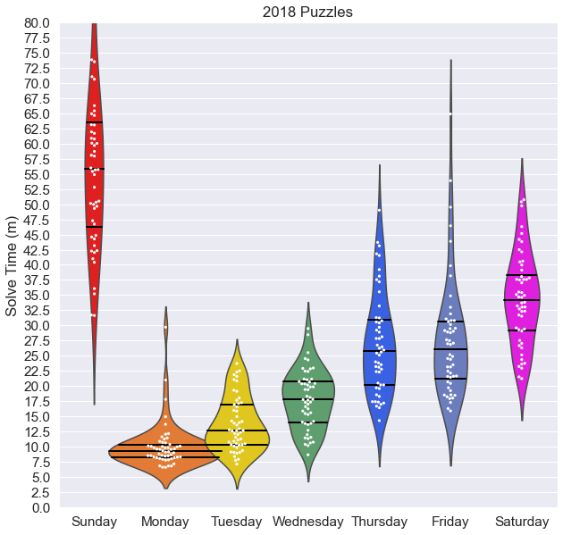
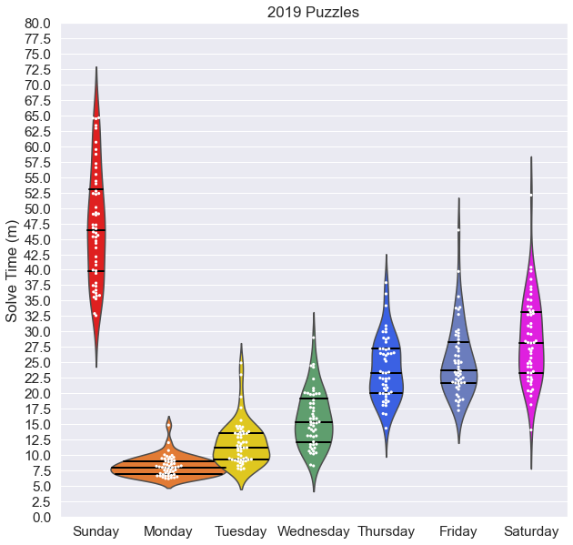
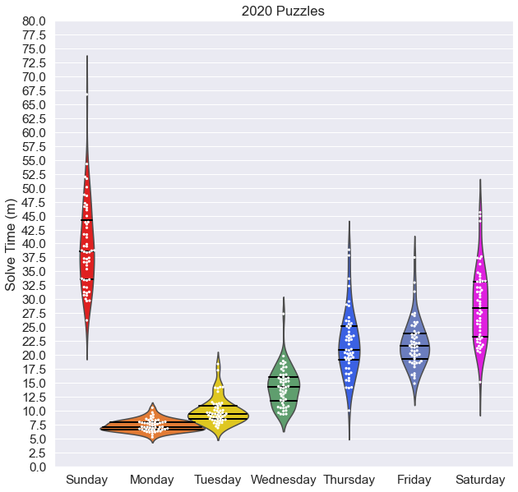
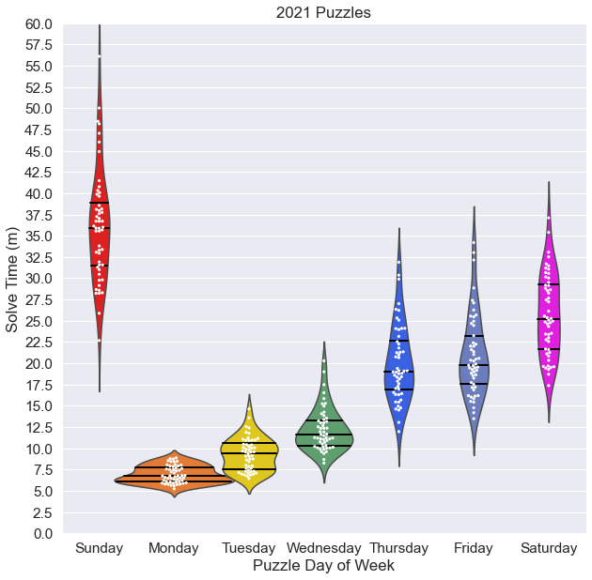
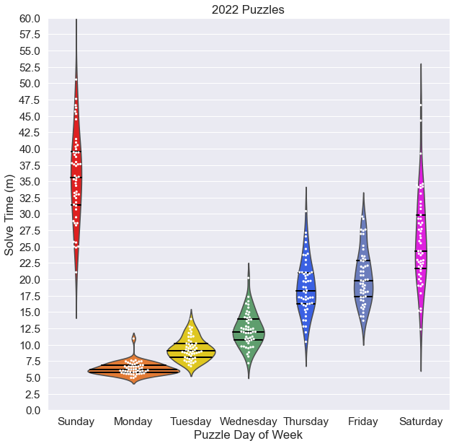
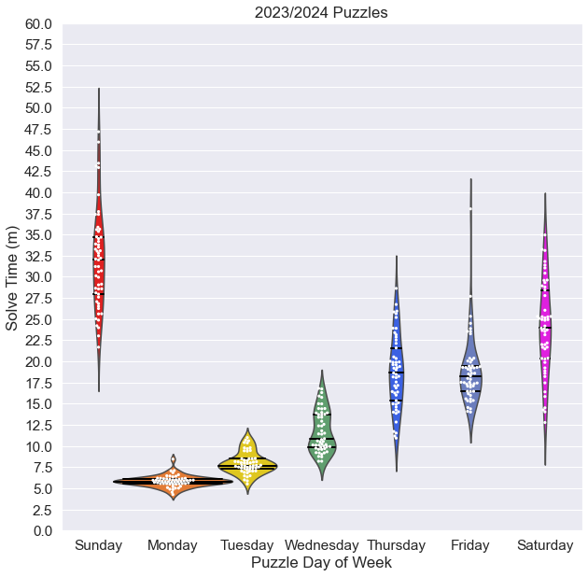
Notes:
Fig 4

Slide 5
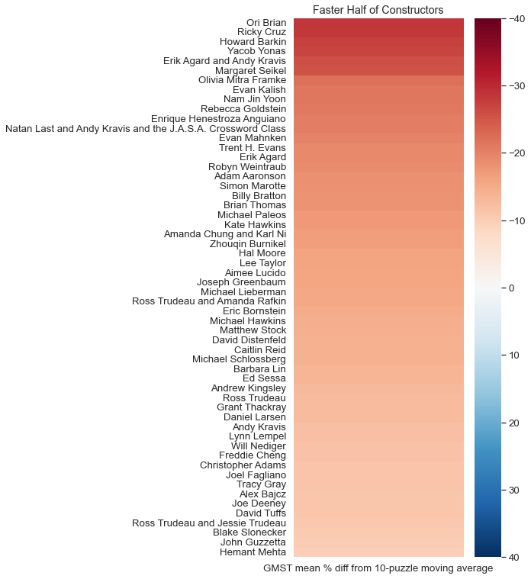
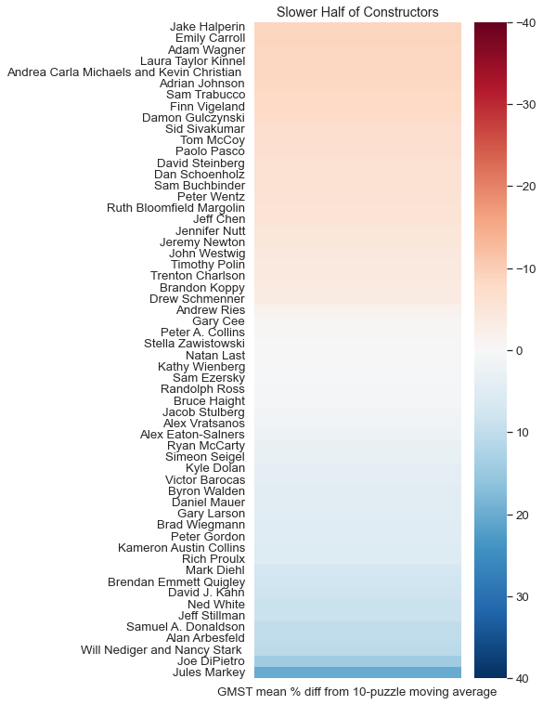
Notes:
Fig 5

Slide 6
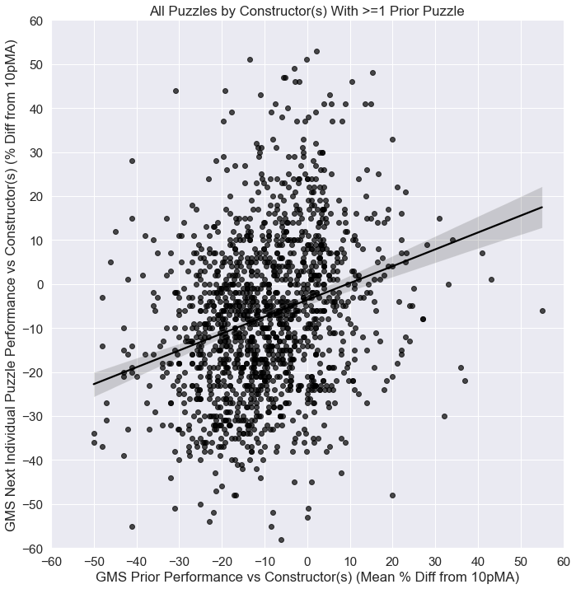
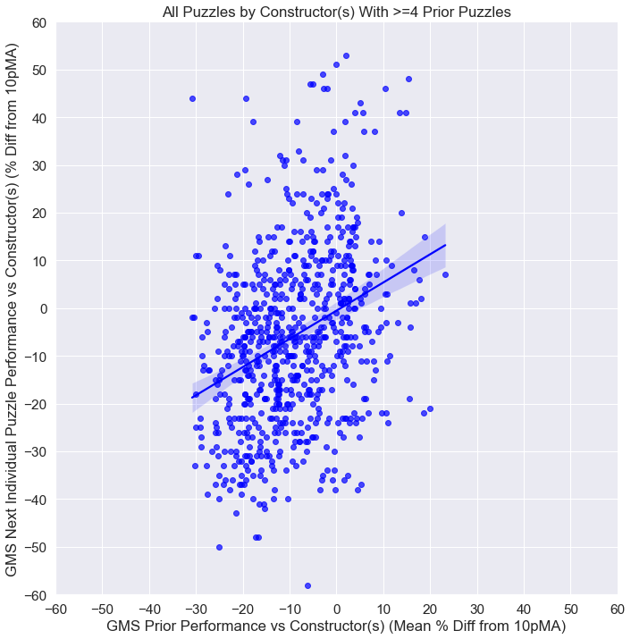
Notes:
Fig 6

Slide 7
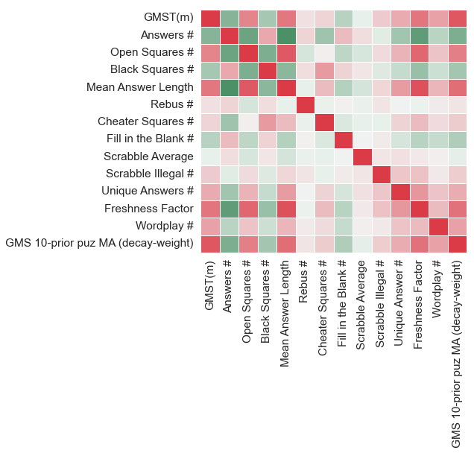
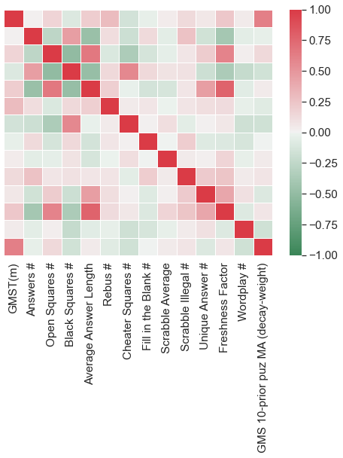
15x15 Puzzles (Mon-Sat)
21x21 Puzzles (Sun)
Clue/Answer
Content
Past
Results
Clue/Answer
Content
Past
Results
Grid Features
Grid Features
Notes:
Fig 7

Slide 8
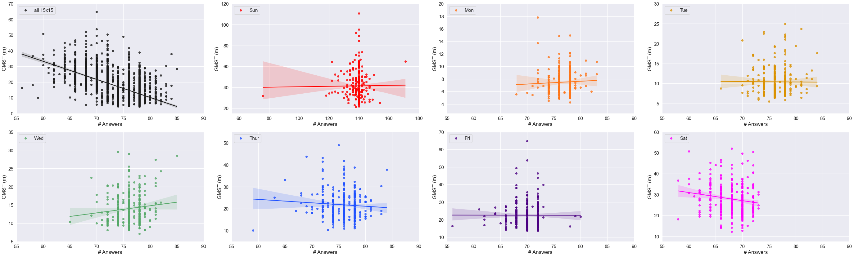
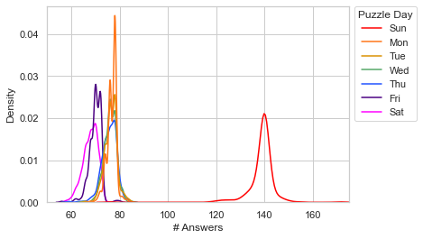
Notes:
Figure 7

Slide 9
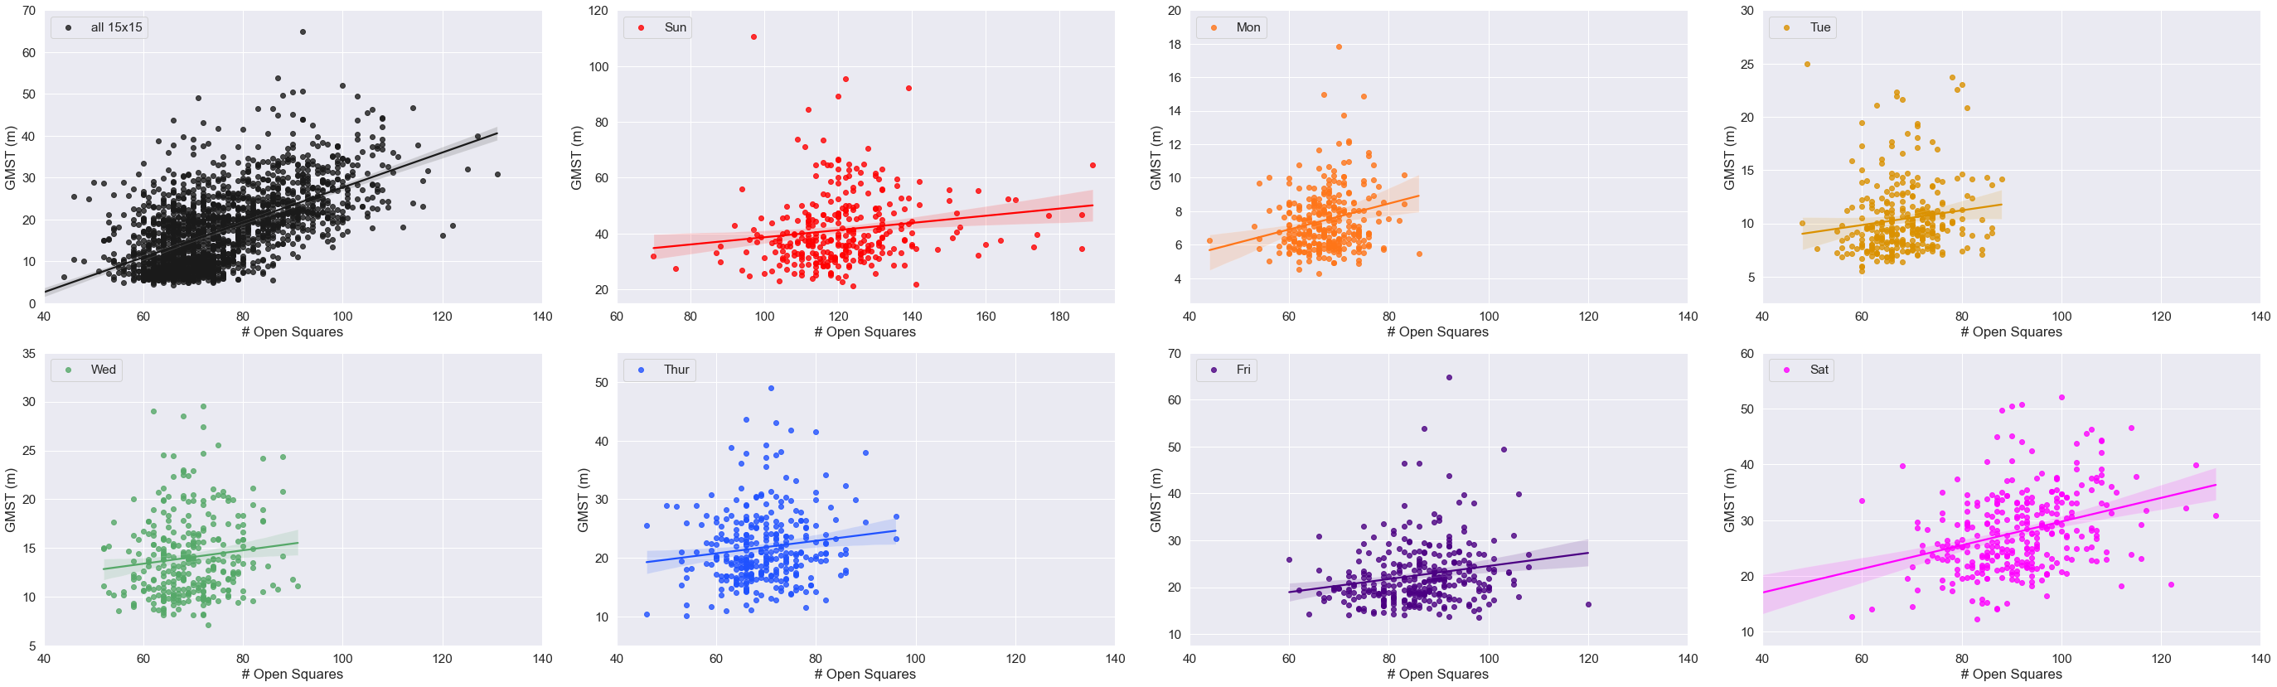
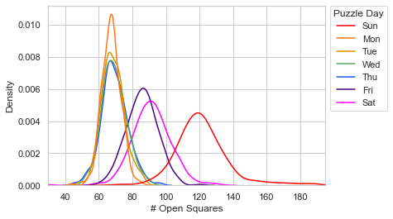
Notes:
Figure 8

Slide 10
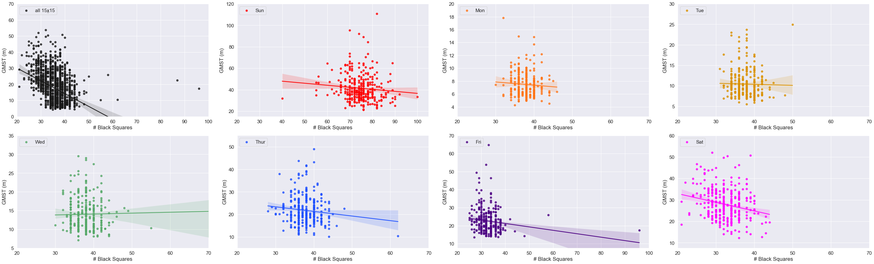
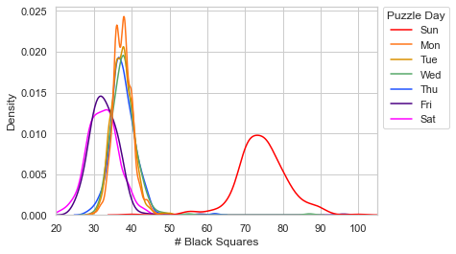
Notes:
Figure 9

Slide 11
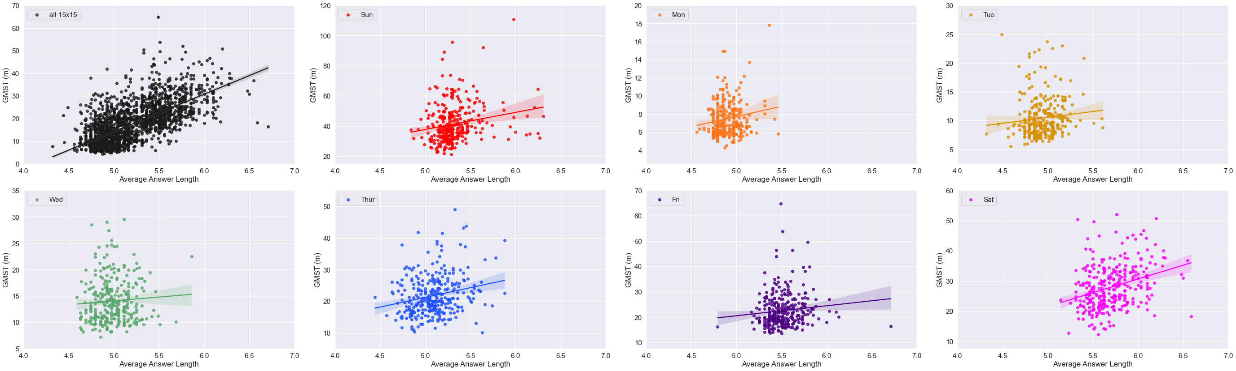
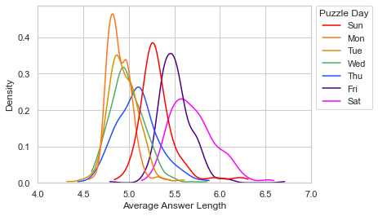
Notes:
Figure 10

Slide 12
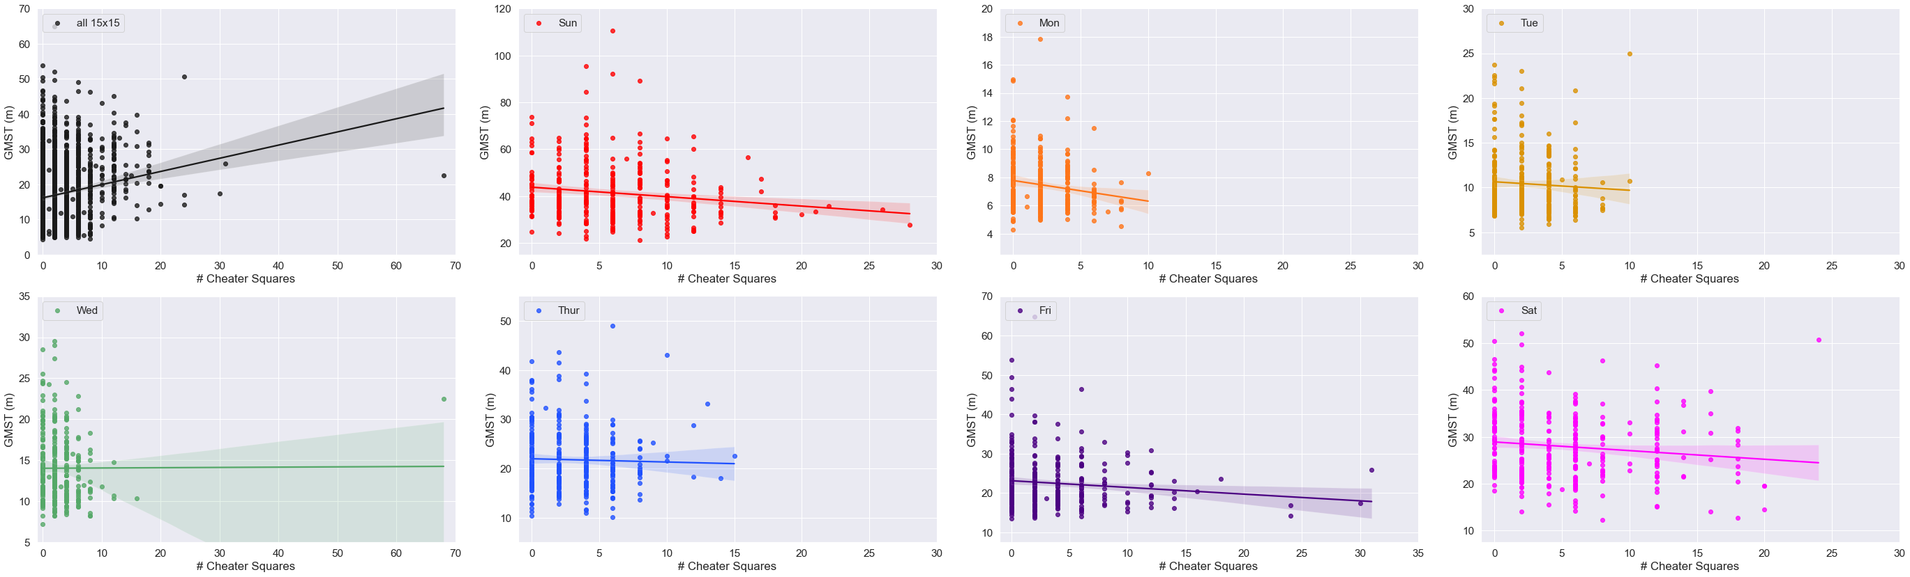
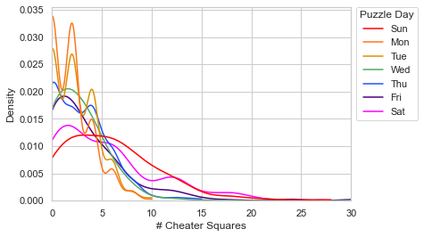
Notes:
Figure 11

Slide 13
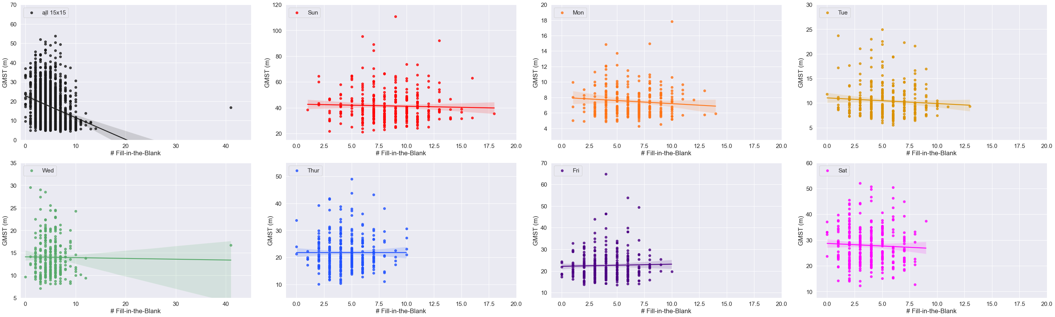
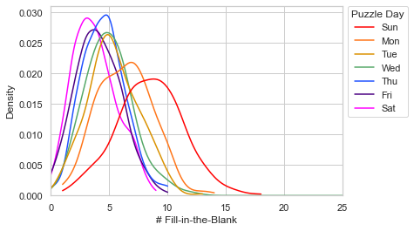
Notes:
Figure 12

Slide 14
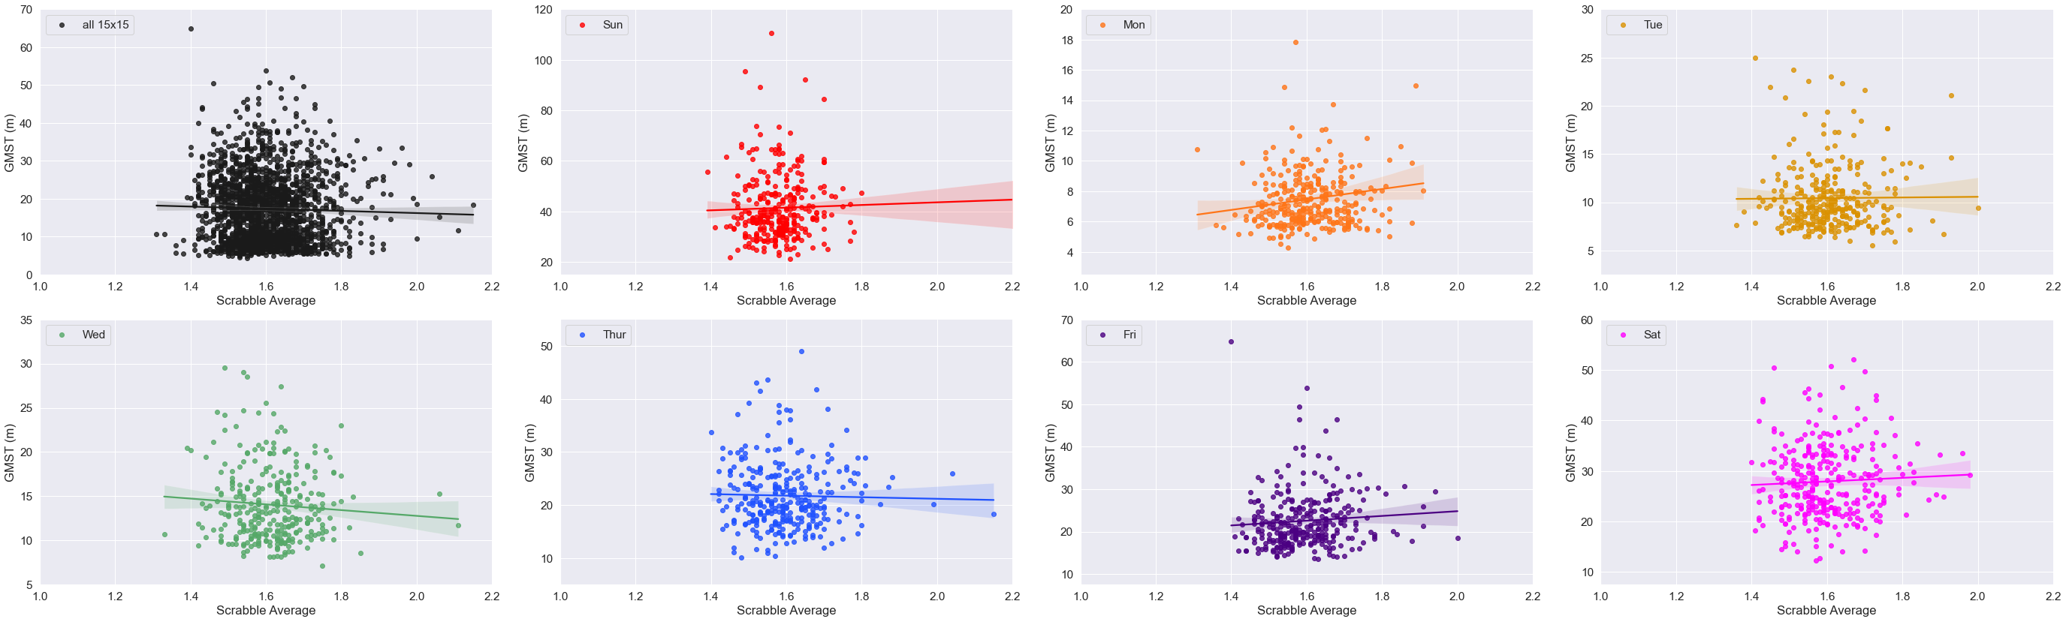
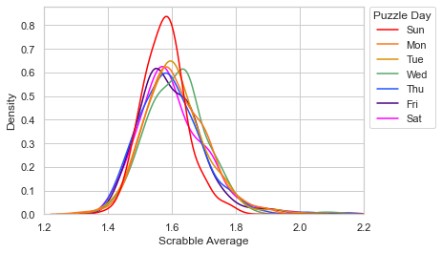
Notes:
Figure 13

Slide 15
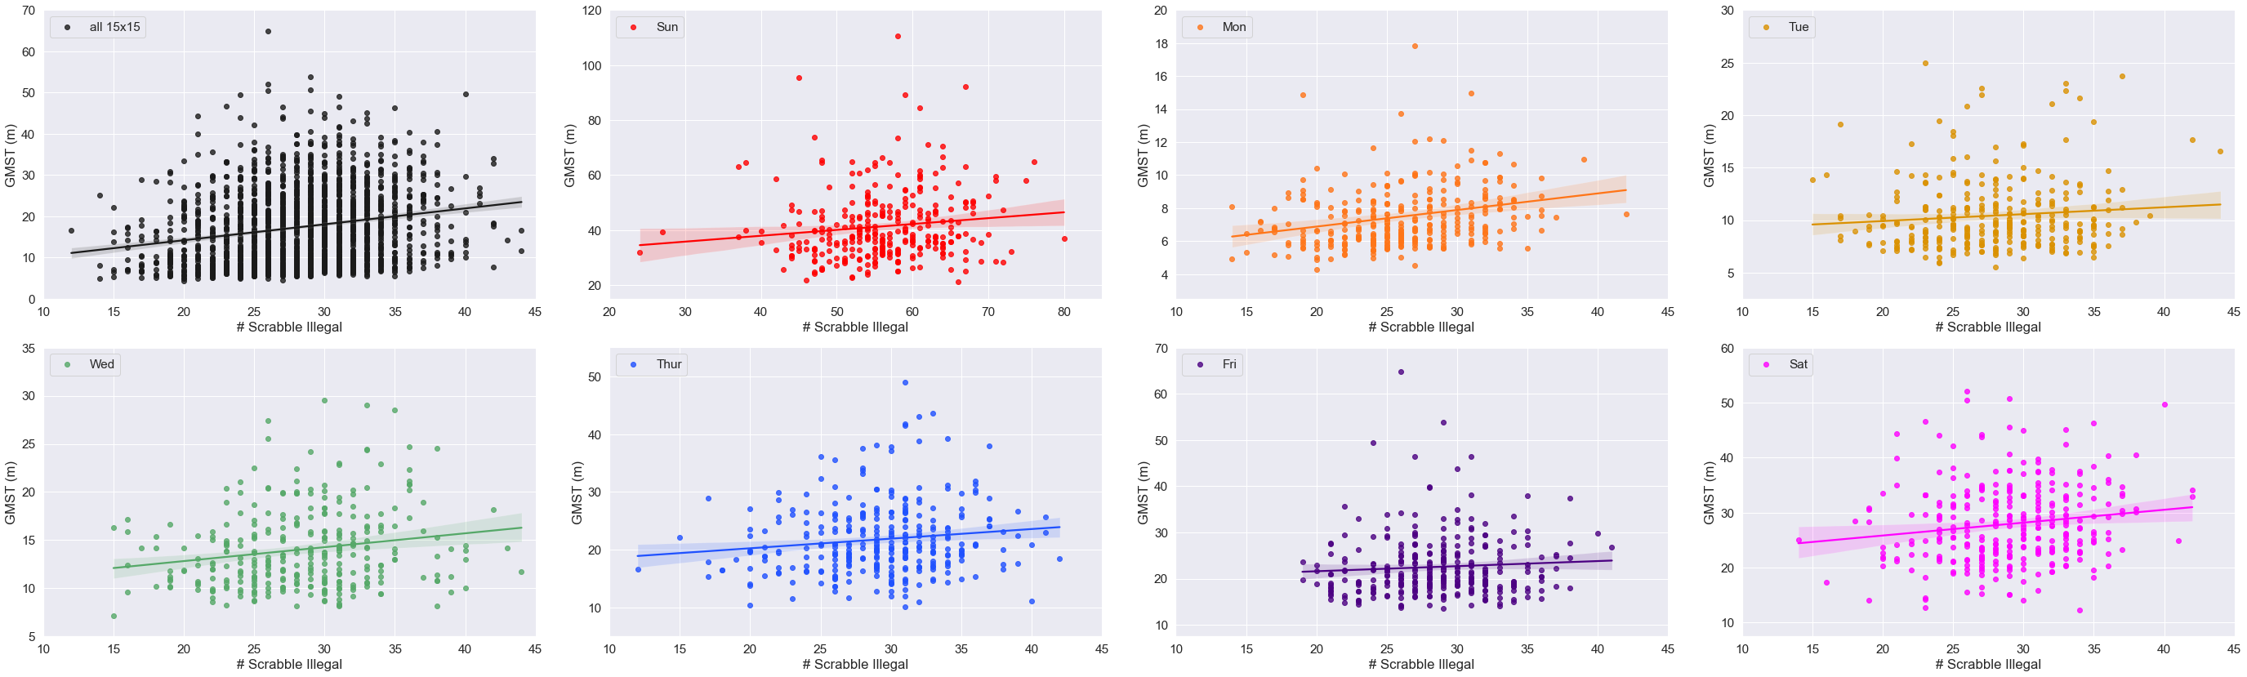
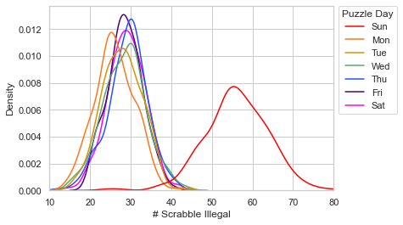
Notes:
Figure 14

Slide 16
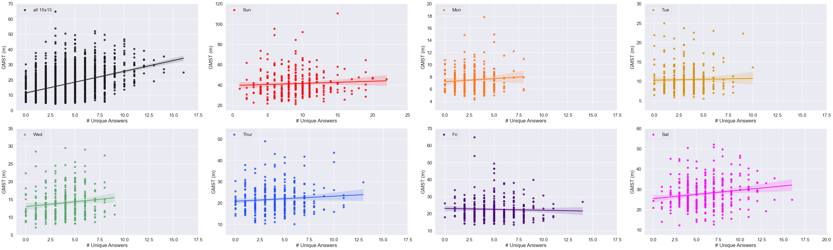
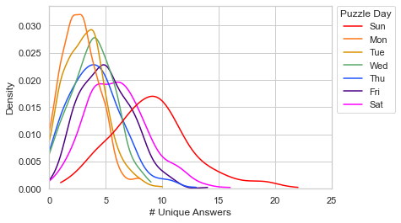
Notes:
Figure 15

Slide 17
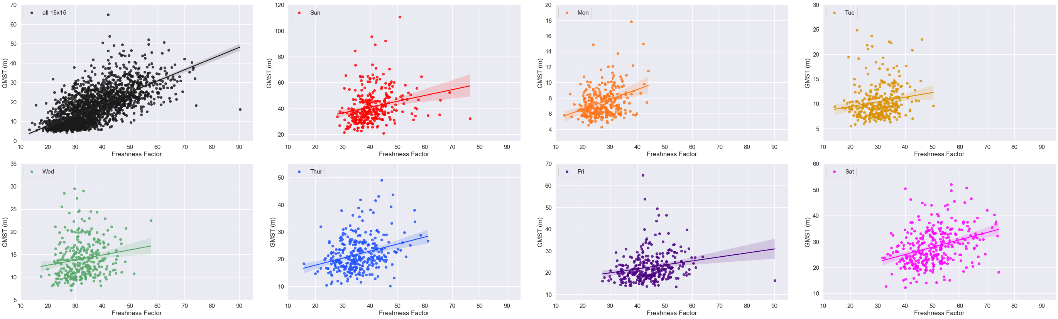
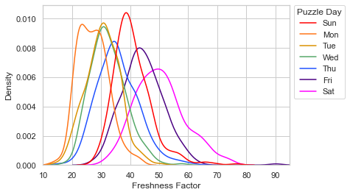
Notes:
Figure 16

Slide 18
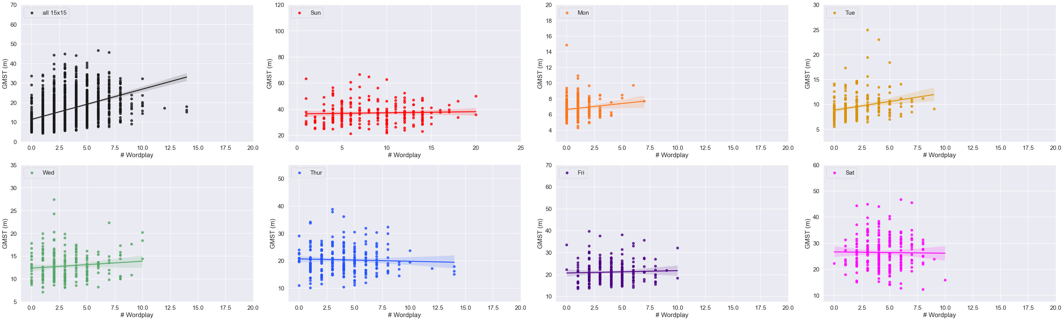
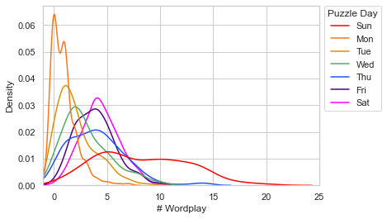
Notes:
Fig. 17

Slide 19
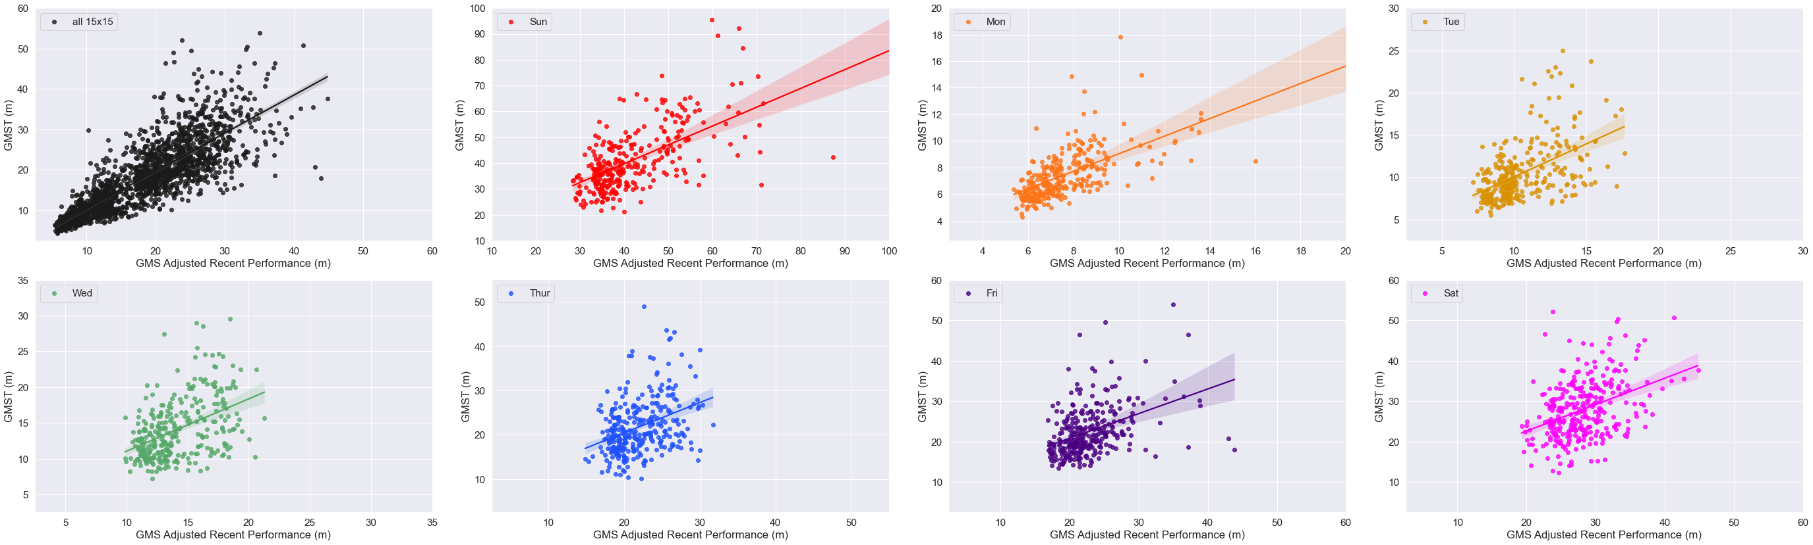
Notes:
Fig. 18

Slide 20
Supplemental Figures and Tables

Slide 21
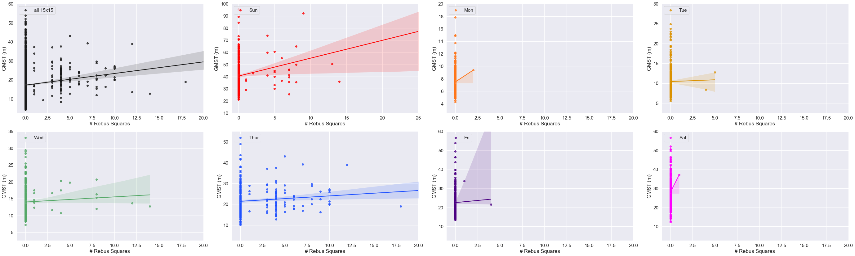
Notes:
Supp. Fig. 1

Slide 22
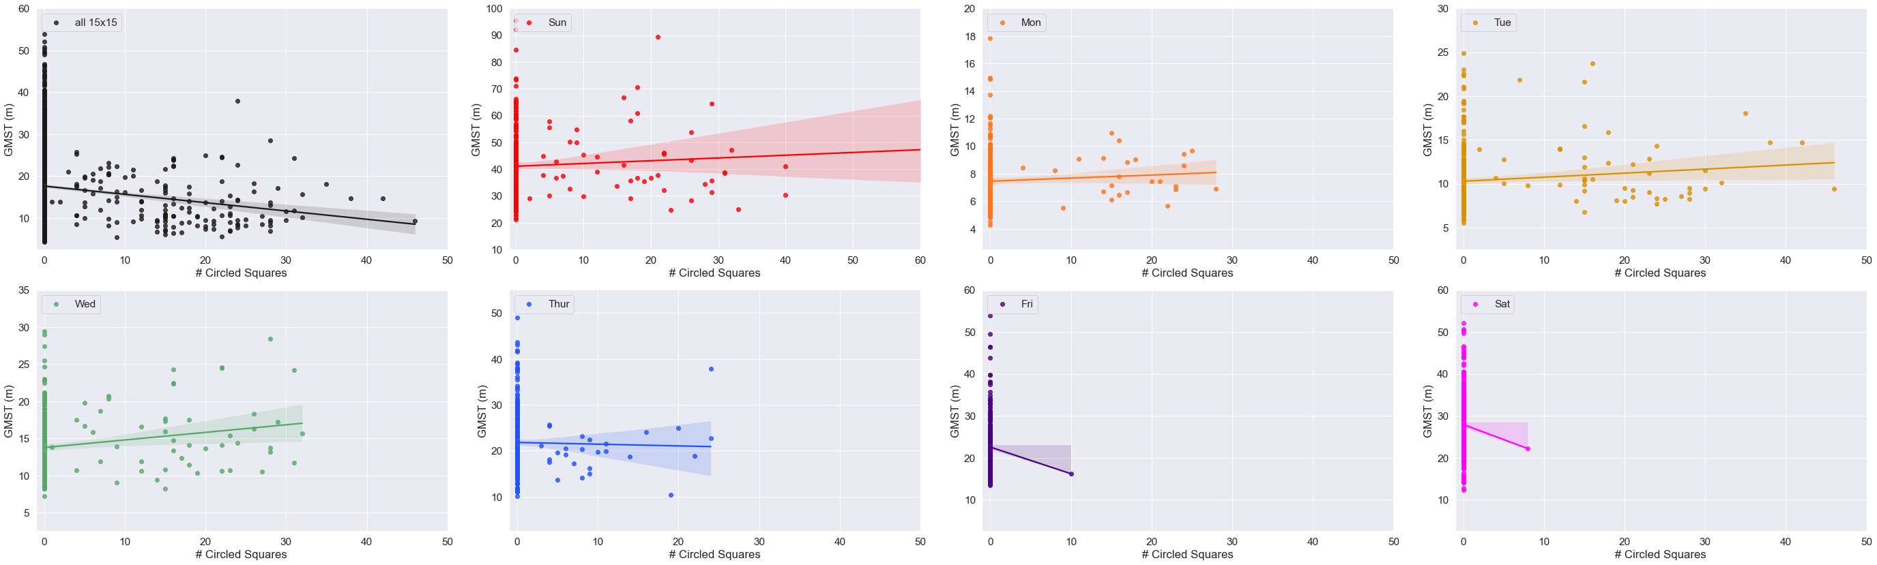

Slide 23
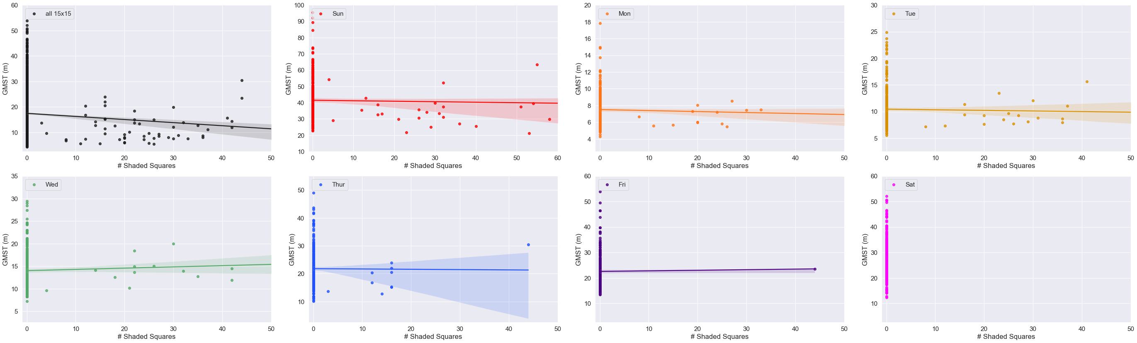

Slide 24
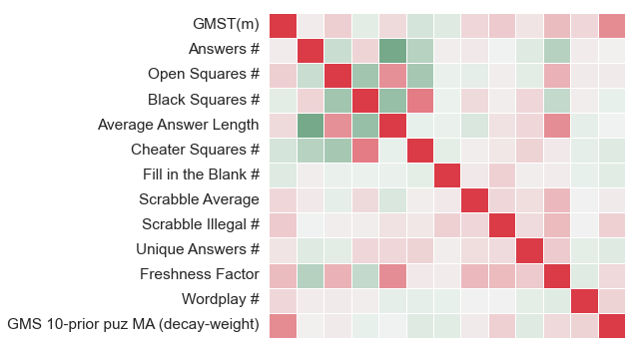
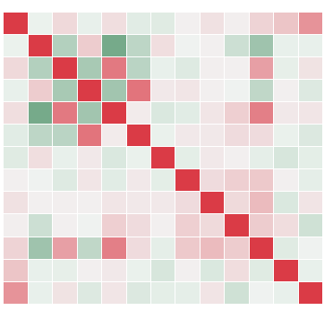
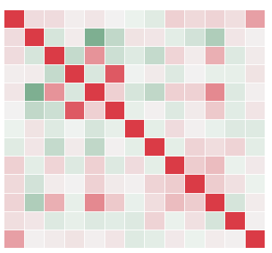
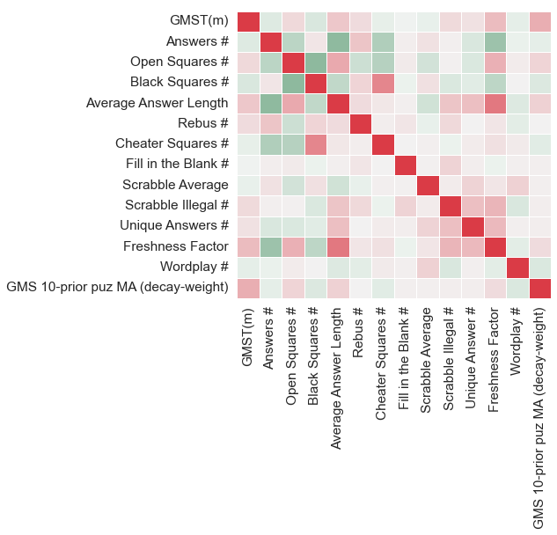
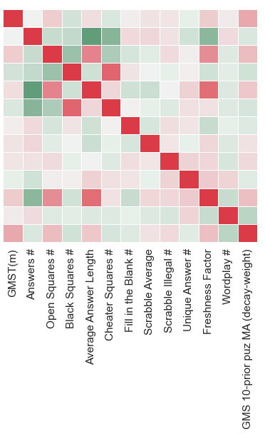
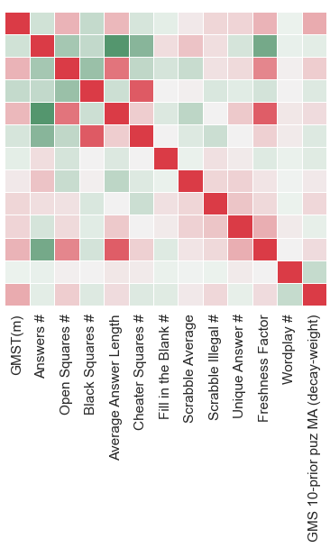
Monday
Tuesday
Wednesday
Thursday
Friday
Saturday
Notes:
Supp. Fig. 4

Slide 25
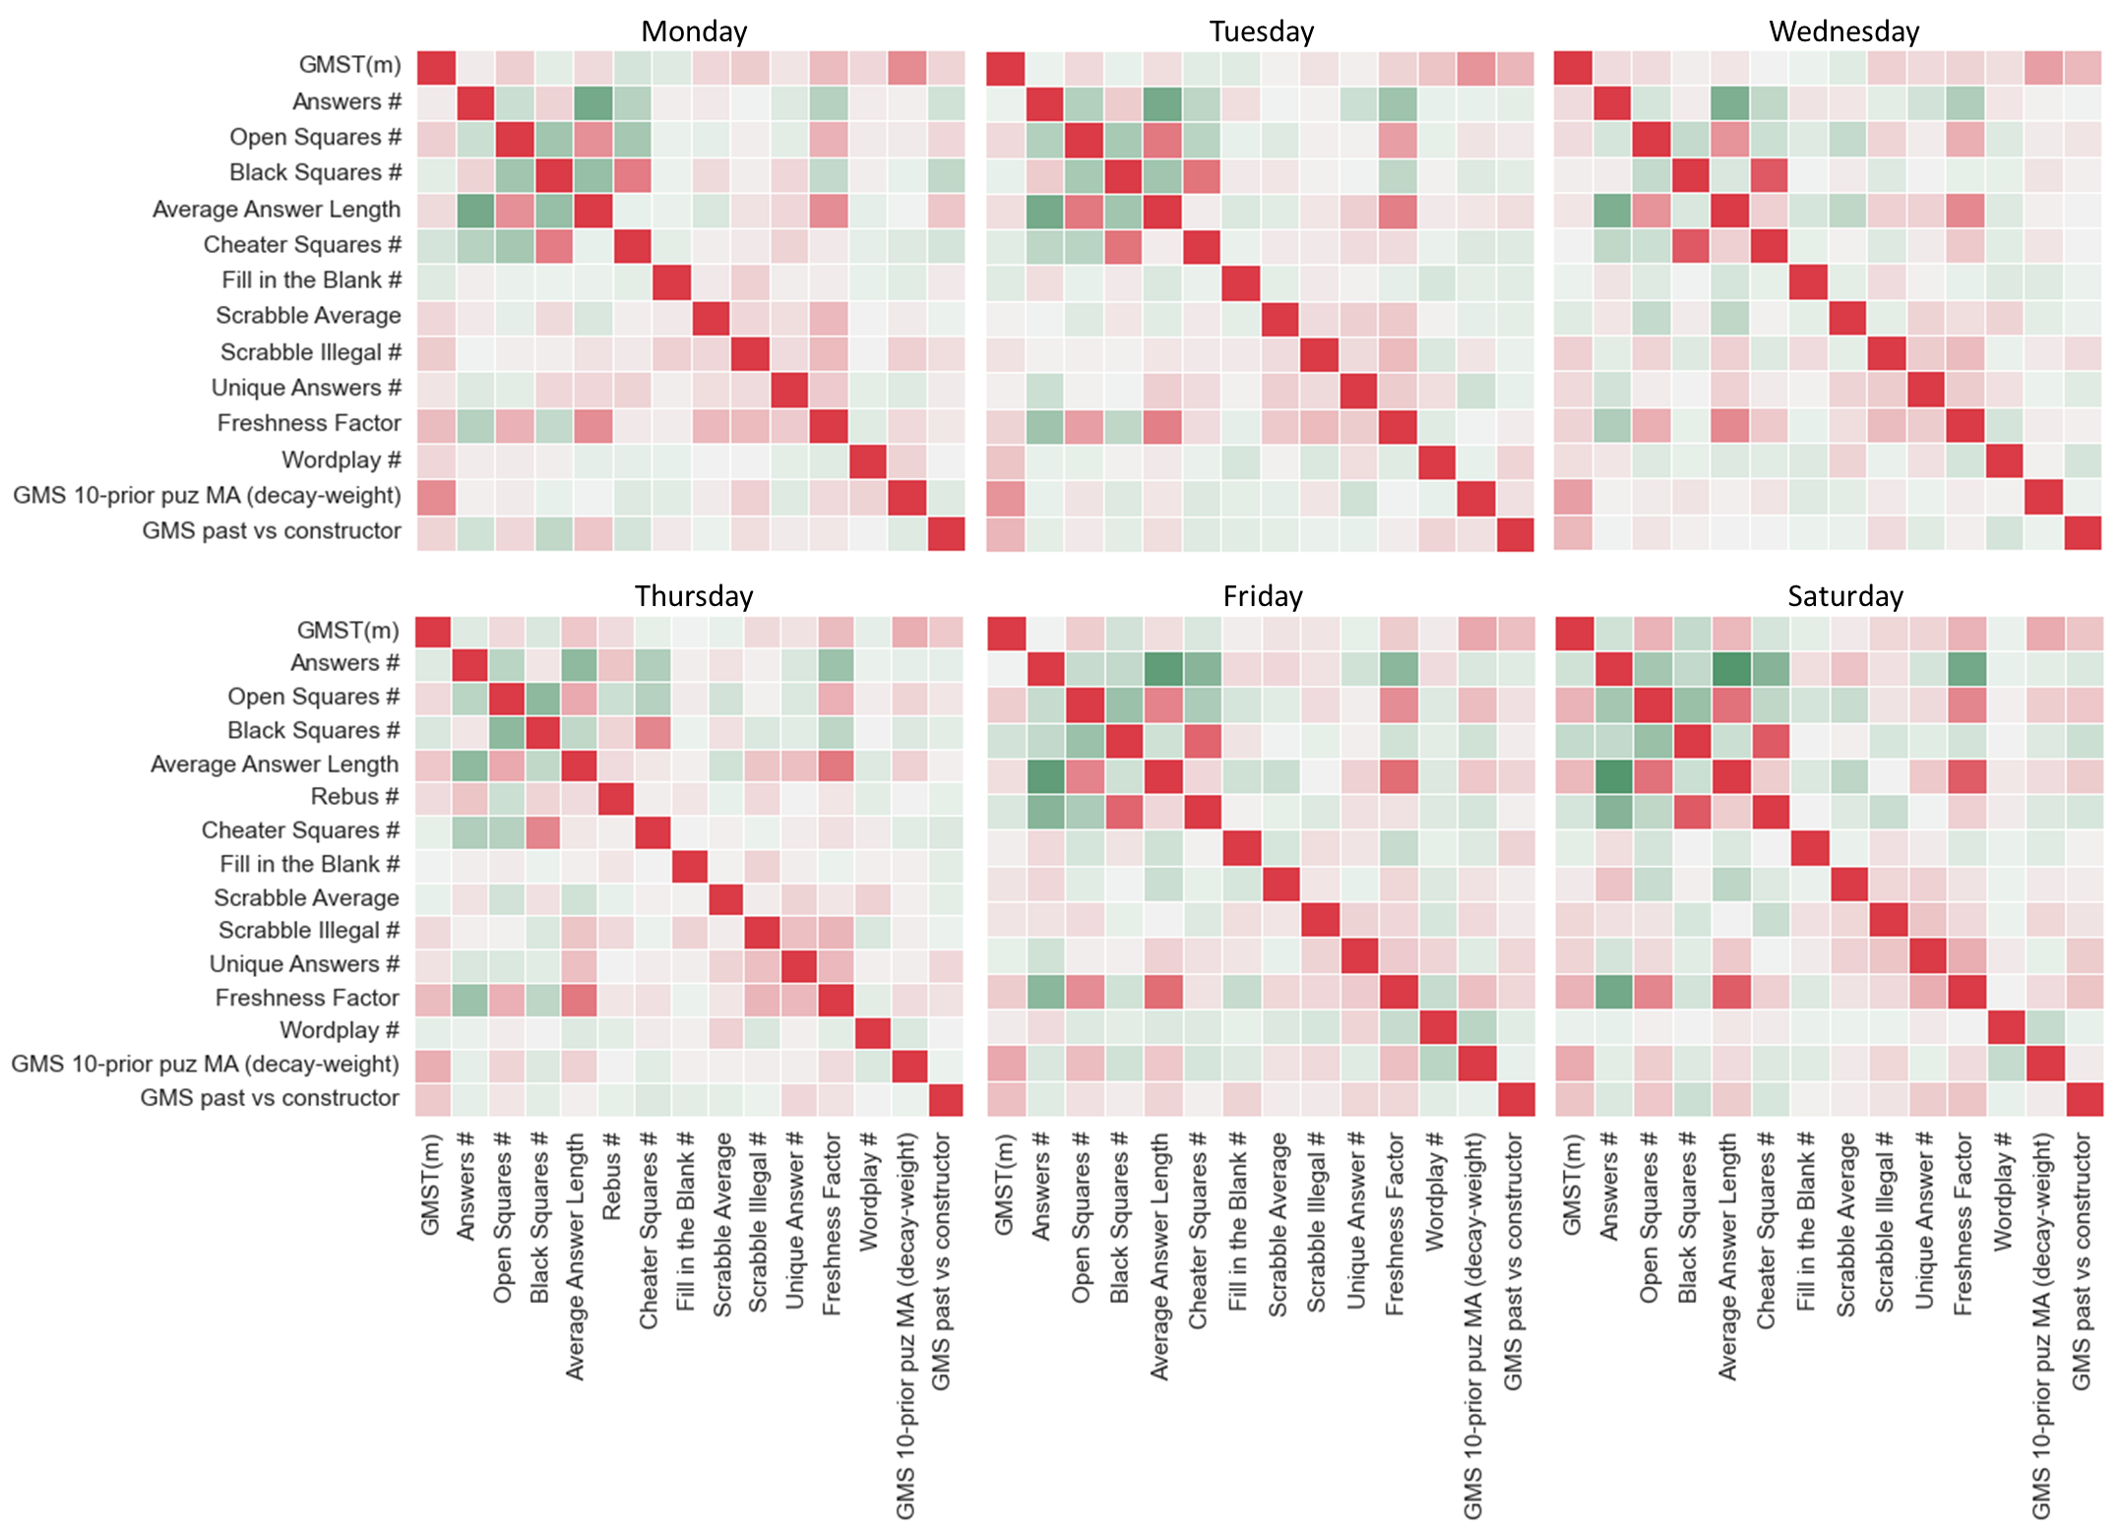
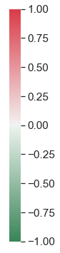
Notes:
Supp. Fig. 4

Slide 26
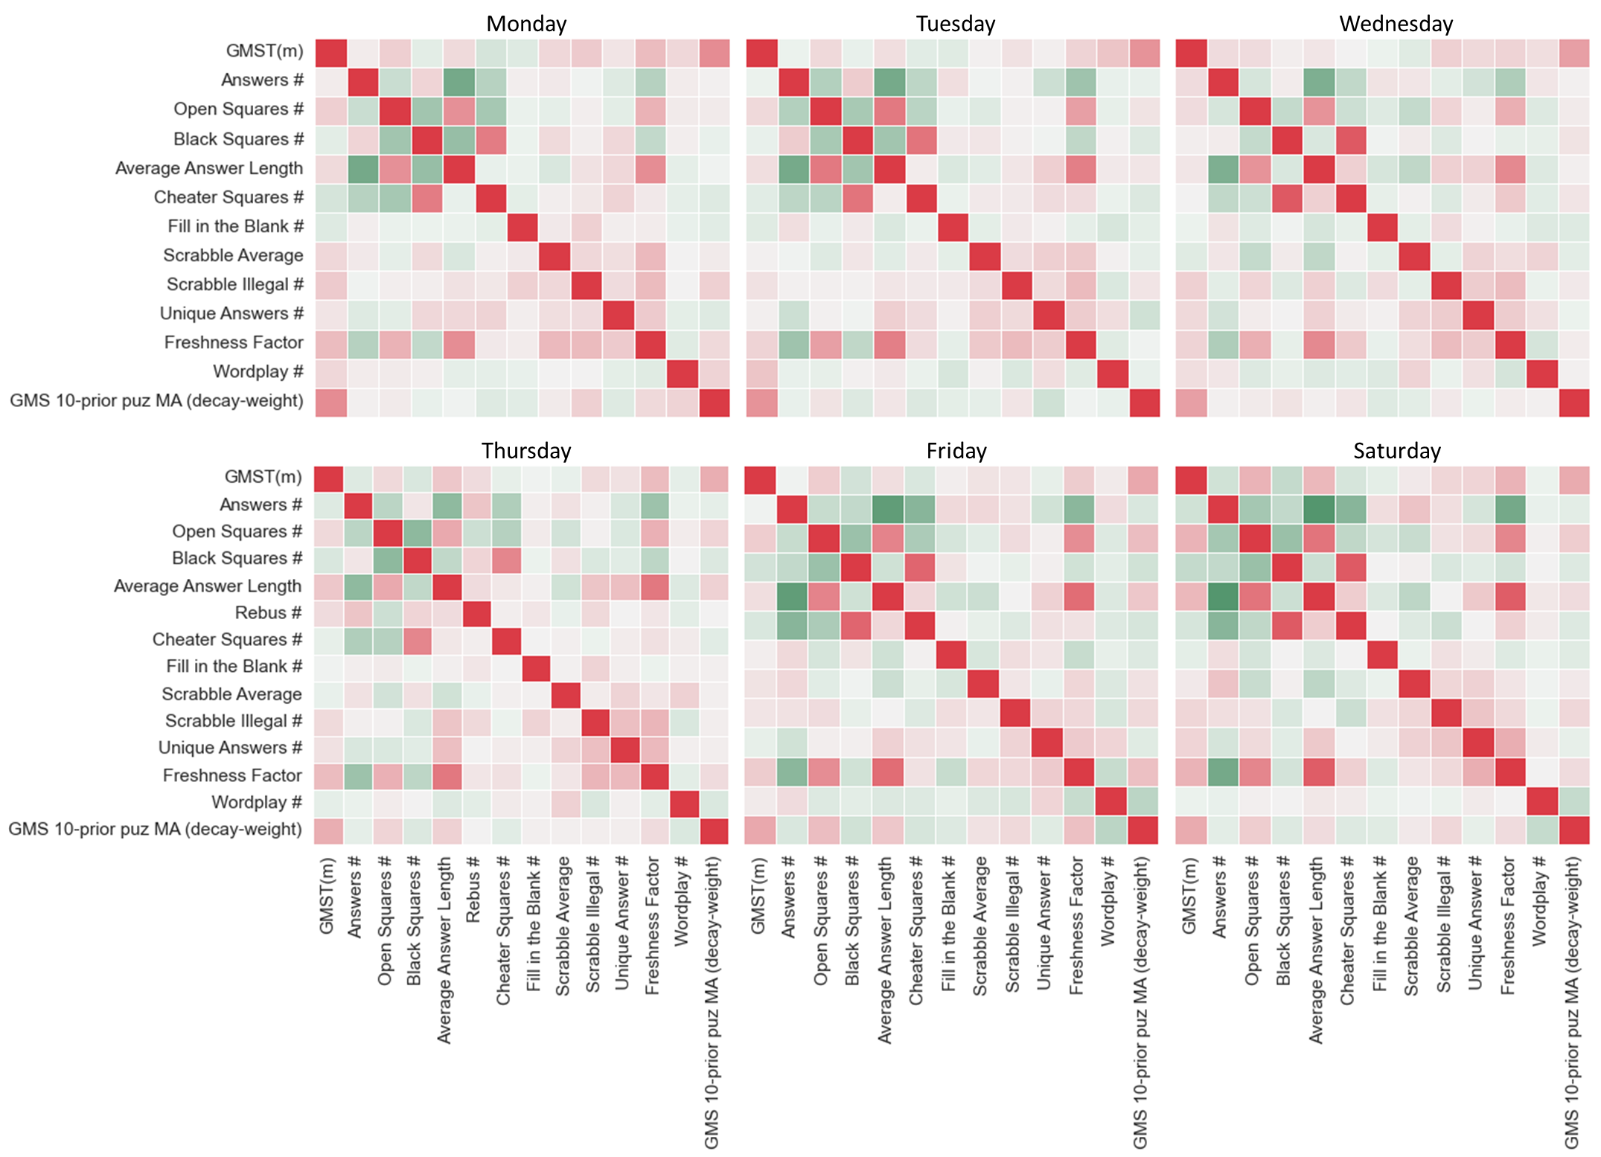

Slide 27
Puzzle Feature | Class | Source | Notes
Answer # | Grid Feature | XWord Info | XWord Info calls answers “words”
Average Answer Length | Grid Feature | XWord Info | XWord Info calls answers “words”
Blocks # | Grid Feature | XWord Info | Blocks = black squares
Cheater Square # | Grid Feature | XWord Info | Blocks than can be removed without affecting the overall word count of the grid
Circle # | Grid Feature | XWord Info | Mostly seen in early week and Sunday puzzles
Cross Reference Clues # | Clue Feature | XWord Info | Clue that refers to another clue (ex. “See 48-Down”)
Duplicate Clues # | Clue Feature | XWord Info | When the same clue verbiage is used for more than one answer
Fill-in-the-Blank # | Clue/Answer Feature | XWord Info
Freshness Factor | Answer Feature | XWord Info | Assigns an overall rarity score to a puzzle’s answers, using both pre-Shortz and Shortz puzzles
Open Squares # | Grid Feature | XWord Info | Counts all white squares that are non-adjacent to black squares
Overall Freshness %ile | Answer Feature | XWord Info | Assigns percentile across all puzzles from all days for Freshness Factor
Rebus # | Grid/Answer Feature | XWord Info | Counts number of squares where more than one letter, number or symbol is required for a solve
Rebus Unique # | Grid/Answer Feature | XWord Info | Same as above, but only counts squares with unique rebus content in the given puzzle
Scrabble Average | Answer Feature | XWord Info | Treats each white square like a (non-blank) Scrabble tile and assigns per-square average point value
Scrabble Illegal # | Answer Feature | XWord Info | Counts all answers that would not be playable based on the Official Scrabble Dictionary
Scrabble Score | Answer Feature | XWord Info | Treats each white square like a (non-blank) Scrabble tile and assigns total point value for the puzzle
Shade # | Grid Feature | XWord Info | Counts all shaded squares in the grid; mostly seen in early week and Sunday puzzles
Spans # | Grid Feature | XWord Info | Counts # of row or columns with 0 black squares (15 or 21 answer length, depending on grid size)
Stacks # | Grid Feature | XWord Info | Counts # of times two or more adjacent rows or columns have all white squares (mostly Fri or Sat)
Unique Answer # | Answer Feature | XWord Info | Counts all answers not occurring in any other pre-Shortz or Shortz Era puzzle
Unused Letters # | Answer Feature | XWord Info | Counts the number (out of 26) of letters not used in a puzzle (0= pangram)
Unusual Symmetry | Grid Feature | XWord Info | Assigns ‘1’ to all puzzles displaying other than normal rotational symmetry (e.g., L-R Mirror or Diagonal)
Wordplay # | Clue Feature | Manual (me) | Subjective count of clues displaying wordplay/punnery; many end with a ‘?’, ‘perhaps’, or ‘maybe’

